Slide 1
CALORIE CALCULATOR
MINI PROJECT: TEAM MEMBERS: M.AHAMMED HUSSAIN V.THRINATH REDDY G.VISWANATH SHARMA

Slide 2
PROBLEM STATEMENT
User Registration and Login
Input of personal details (age, gender, height, weight)
Selection of activity level
Automatic calculation of Basal Metabolic Rate (BMR)
Daily calorie requirement calculation

Slide 3
METHODOLOGY
User Registration/Login: Users create an account and log in to the system.
Enter Personal Details :Users enter age, gender, height, weight, and activity level.
Calculate Calories: The system calculates the user's daily calorie requirement using standard formulas.
Display Results: The calculated daily calories are displayed along with suggestions for:
Weight Maintenance
Weight Loss
Weight Gain
Store Data :User details and calculation history are saved in the database.

Slide 4
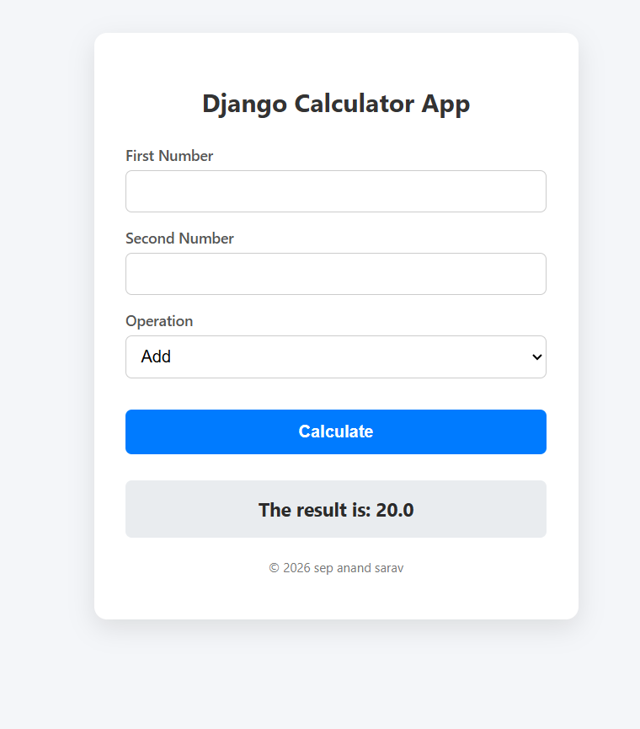
OUTCOME
The Calorie Calculator using Django successfully calculates the daily calorie requirements of users based on their age, gender, height, weight, and activity level. The system provides personalized calorie recommendations for maintaining, losing, or gaining weight. It offers a simple and user-friendly interface, stores user data securely, and helps users make informed decisions about their diet and fitness goals.

Slide 5
CONCLUSION
The Calorie Calculator using Django is a useful web application that helps users determine their daily calorie needs quickly and accurately. By using personal information such as age, gender, height, weight, and activity level, the system provides personalized calorie recommendations. The application is easy to use, efficient, and supports users in maintaining a healthy lifestyle and achieving their fitness goals.

